Slide 1
Emotional Intelligence

Slide 2
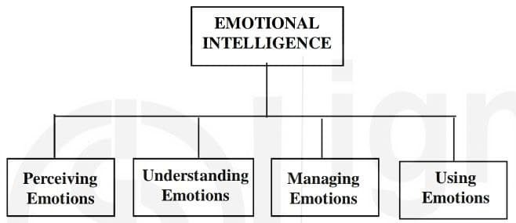
In 1990, Yale psychology professor Peter Solovay and the University of New Hampshire‘s John Mayer coined the phrase “emotional intelligence” to describe a set of abilities that amount to “emotional smarts.”
Emotional intelligence (also referred to as EQ or emotional quotient) is defined as an ability to monitor and regulate one’s own and others’ emotions and to use emotions to facilitate one’s thoughts and actions.

Slide 3
Emotional Intelligence is a better predictor of success in leadership than IQ
IQ is still recognized as an important element of success, particularly when it comes to academic achievement. People with high IQs typically to do well in school, often earn more money, and tend to be healthier in general.
But today experts recognize that IQ is not the only determinant of life success. Instead, it is part of a complex array of influences—one that includes emotional intelligence. Many companies now mandate emotional intelligence training and use EQ tests as part of the hiring process.

Slide 4
Why is EQ important at workplace?
Using emotional intelligence in the workplace can improve decision making, help social interactions run smoothly, and enhance employees’ ability to deal with stressful times.
EQ has been linked to better task performance, organizational citizenship behaviors of employees, higher company rank, and higher scores of stress tolerance and interpersonal facilitation.
Emotional intelligence, particularly understanding and managing emotions, was strongly related to (positive) transformational leadership behaviors of senior managers.

Slide 5
Key elements of Emotional Intelligence
1. Self-awareness: If you're self-aware, you always know how you feel, and you know how your emotions and your actions can affect the people around you. Being self-aware when you're in a leadership position also means having a clear picture of your strengths and weaknesses.
Additionally, when we know ourselves well, we can be more effective communicators since we are able to better understand the other person and what they might be looking for in a conversation.
Finally, by being self-aware, we can work on improving ourselves and our lives in ways that are meaningful to us and can engage in self-evaluation, we can give some thought to whether we are thinking and feeling and acting as we “should” or following our standards and values. This is referred to as comparing against our standards of correctness.

Slide 6
2. Self-regulation: Self-regulation is all about staying in control. Leaders who regulate themselves effectively, rarely verbally attack others, make rushed or emotional decisions, stereotype people, or compromise their values emerge beneficial in the workplace.
How can you improve your ability to self-regulate?
Know your values – Do you have a clear idea of where you absolutely will not compromise? Do you know what values are most important to you? Spend some time examining your "code of ethics." If you know what's most important to you, then you probably won't have to think twice when you face a moral or ethical decision – you'll make the right choice.

Slide 7
Hold yourself accountable – If you tend to blame others when something goes wrong, stop this behavior immediately. Make a commitment to admit to your mistakes and to face the consequences, whatever they are.
Practice being calm

Slide 8
3. Motivation: Self-motivated leaders work consistently toward their goals, and they have extremely high standards for the quality of their work. People with high emotional intelligence tend to be highly motivated as well, which makes them more resilient and optimistic. They find ways to enjoy life even during difficult times, and they're always looking for ways to improve themselves. This makes them more successful in all areas of their lives.
Re-examine why you're doing your job, Know where you stand, Be hopeful and find something good.

Slide 9
4. Empathy: For leaders, having empathy is critical to managing a successful team or organization. Leaders with empathy have the ability to put themselves in someone else's situation. They help develop the people on their team, challenge others who are acting unfairly, give constructive feedback, and listen to those who need it. Lastly, people with empathy and compassion tend to be more altruistic, and they are more likely to go out of their way to help others.
Put yourself in someone else's position, Pay attention to body language, respond to feelings.
5. Social Skills: Leaders who do well in the social skills element of emotional intelligence are great communicators. How can one develop social skills?- conflict resolution, Improve your communication skills and learn how to praise others.

Slide 10
Relationship Management: Relationship management is the process of building and maintaining positive relationships with customers, clients, partners, and others who can help the organization achieve its goals. Effective relationship management can result in increased sales, improved customer loyalty, and higher levels of customer satisfaction.

Slide 11
How can one improve EQ
Learn how to label and respect emotions
Observe thoughts and beliefs
Learn from observing others
Indulge in self evaluation
Practice mindful communication (
The tenets of mindfulness — non-judgment, receptivity, curiosity, and compassion — are extended to social interactions. This applies to listening and speaking).

